Slide 1

Spatial Filtering and Image Enhancement
A comprehensive study of spatial domain enhancements, neighborhood operations, correlation, convolution, and edge optimization.
By Ahmed Yousry Abdelstar Zaalook
Grand Institute for Practical Application
Slide 1

Slide 2


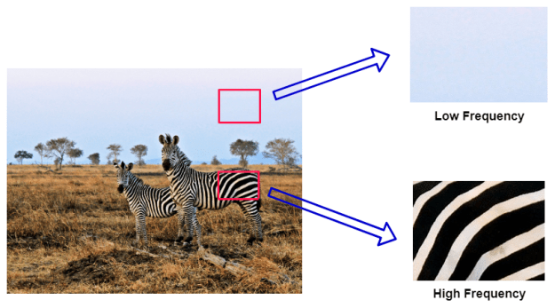
Filters in Image Processing
Spatial filtering modifies an image by directly manipulating the intensity of pixels within a local neighborhood.
High Frequencies: Represent rapid variations in brightness (e.g., crisp details, texture transitions, and sharp edges).
Low Frequencies: Capture gradual variations in light intensity (e.g., broad gradients and background shapes).
Fundamentals of Spatial Domain Enhancements
Slide 2

Slide 3
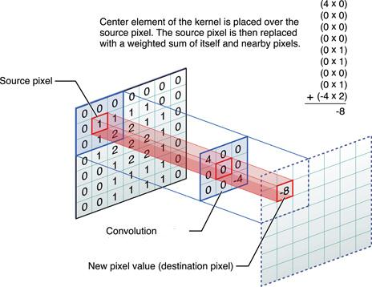





Fundamentals of Spatial Filtering
Spatial filters use a convolution matrix (kernel) applied over a neighborhood. The center of the filter corresponds to the target output pixel.
Filter Kernel
2D Convolution Equation
Edge Conditions
A small coefficient matrix (e.g., 3x3, 5x5) that slides across the pixels to perform neighborhood calculations.
When processing border pixels, spatial coordinates extend outside the image. Solved via zero-padding, mirroring, or clipping.
Where f is the original image, g is the kernel, and j are target coordinates.
Zero padding adds a border of black pixels (0 value) around the image, mirroring reflects the edge pixels outward to create a symmetrical border, and clipping chops off the boundary pixels entirely so no extra padding is needed
Mathematical Foundations
Slide 3

Slide 4
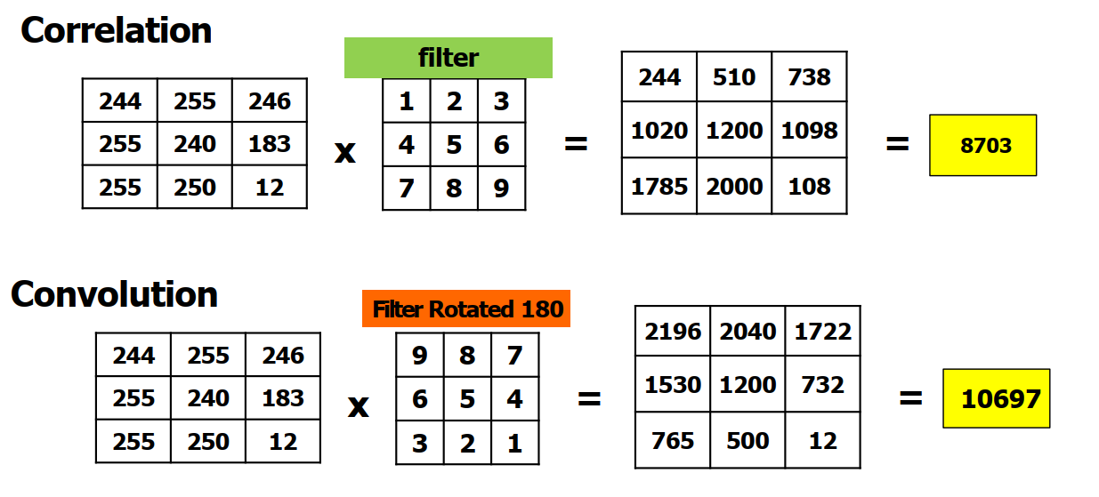




Correlation vs. Convolution
Though functionally similar, correlation and convolution handle kernel orientation differently, which is mathematically vital.
Correlation
Convolution
Correlation moves the filter mask directly over the image and computes the sum of products at each location. It is widely used for template matching and feature finding.
Convolution rotates the filter mask by 180 degrees (both horizontally and vertically) before applying the sum of products. It is commutative and mathematically associative.
Mathematical Filtering Differences
Slide 4

Slide 5

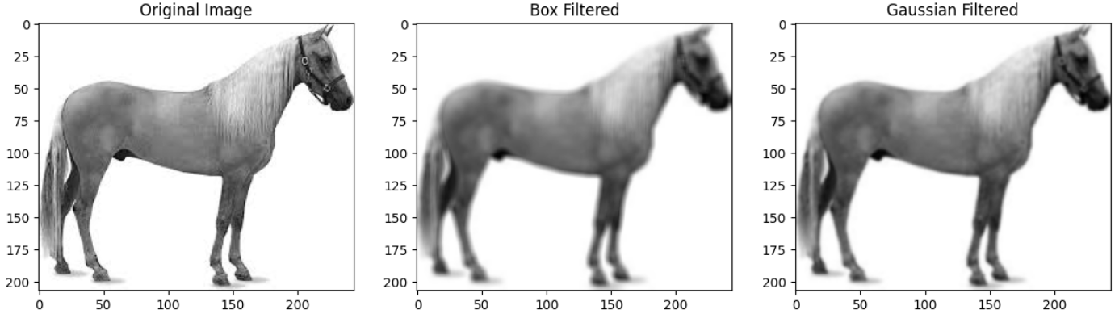


Linear Filters: Box vs. Gaussian
Linear spatial filters compute output pixels using weighted linear combinations of neighborhood pixel values. They are excellent for low-pass smoothing.
Box / Average Filter: Simple averaging filter. Replaces target pixel with the mean of its neighbors. Blurs rapid transitions and edges aggressively.
Gaussian Filter: Uses a 2D Gaussian function to assign weights based on distance, preserving details better than simple box blurs.
Low-Pass Smoothing Operations
Slide 5

Slide 6
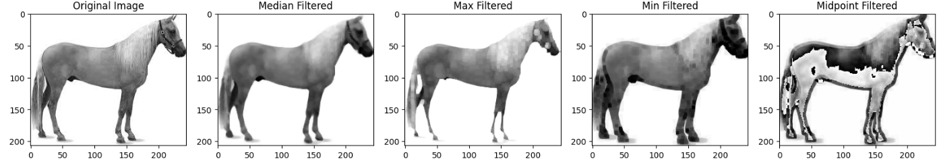
Non-Linear Order Statistics
Non-linear spatial filters do not use a weighted sum. They rank order neighborhood pixels to compute output values.
Median Filter: Replaces target pixel with the median of neighborhood values. Excellent for removing bipolar (salt-and-pepper) noise without blurring edges.
Max & Min Filters: Max filter replaces pixels with the local maximum (eliminates pepper noise). Min filter replaces with local minimum (eliminates salt noise).
Midpoint Filter: Computes the average of maximum and minimum neighborhood values. Ideal for handling uniform or Gaussian noise.
Non-Linear Noise Mitigation
Slide 7

Slide 7
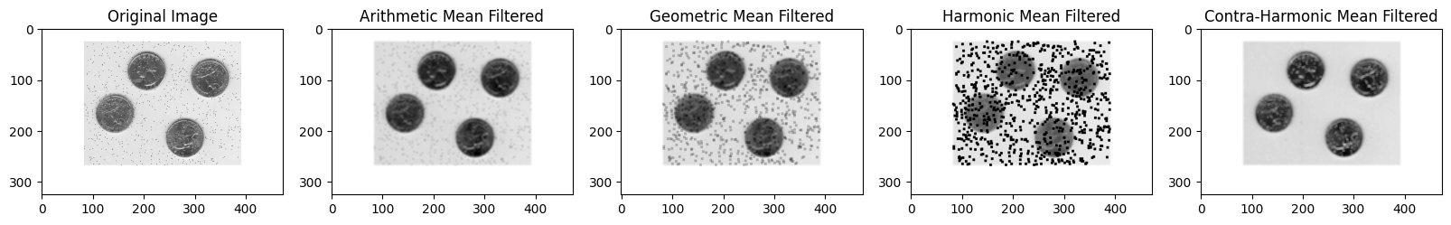









Non-Linear Restoration: Mean Filters
Different noise types demand customized averaging methods. These mathematical variations target specific pixel aberrations.
Arithmetic Mean
Geometric Mean
Harmonic Mean
Contra-Harmonic
Standard pixel averaging. Smoothes local noise variations but blurs boundaries.
Multiplies neighborhood pixels to the power of 1/mn. Retains image details better than arithmetic.
Excellent for removing salt noise. Struggles with pepper noise.
Parameterized by power Q. Removes salt noise (Q < 0) or pepper noise (Q > 0).
Specialized Image Restoration Means
Slide 8

Slide 8
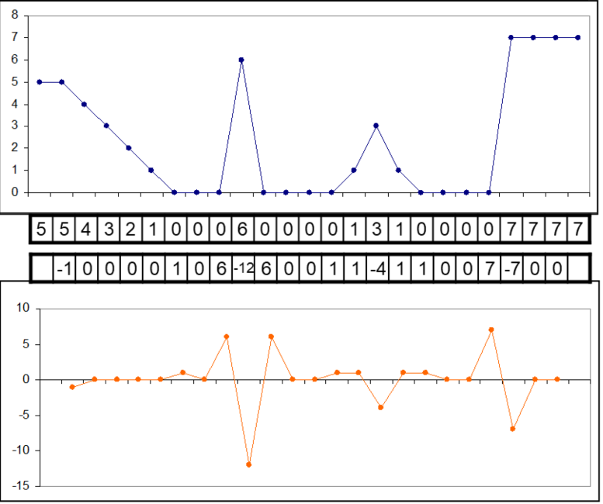





Enhancement & Derivatives
Image sharpening highlights boundaries and transitions. This domain operation is achieved through discrete calculus (differentiation).
Gradient Detection
Acceleration Detection
Calculates differences in adjacent intensity. Produces wider edges and responds strongly to step-like transitions.
Calculates rate of change of differences. Yields finer edge lines, responds strongly to details, and crosses zero at transitions.
Calculus of Image Sharpening
Slide 9

Slide 9



The Laplacian Sharpening Operator
The Laplacian is a rotation-independent, second-order derivative operator used for isotropic edge enhancement.
Standard 3x3 Laplacian Matrix
0 | 1 | 0
1 | -4 | 1
0 | 1 | 0
Discrete Form: Sums the second derivatives in both principal spatial axes.
Center coefficient has opposite sign of outer coefficients. Reverses local gradients to accentuate edge differences.
Sharpening Blend: Sharpens the original image by adding or subtracting the Laplacian:
Isotropic Edge Optimization
Slide 10

Slide 10
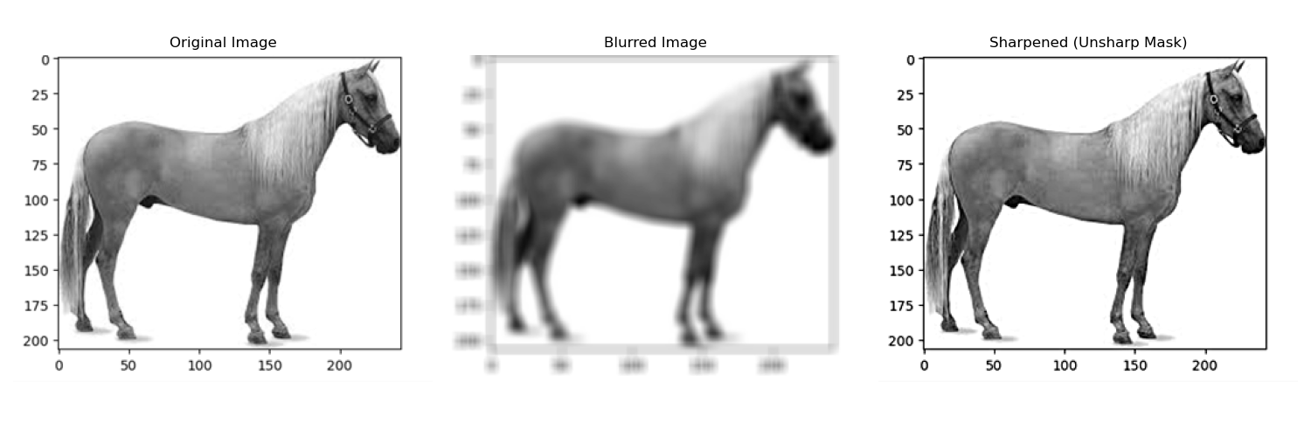
Unsharp Masking Workflow
Unsharp masking extracts detailed edge masks by subtracting smoothed images, combining them with the original:
STEP 1
STEP 2
STEP 3
STEP 4
Smooth Image
Compute Mask
Scale Margin
Final Blend
Create a blurred version of the original image.
Subtract the blurred version from the original.
Configure weight to control sharpness intensity.
Add the scaled mask back onto the original frame.
Traditional Image Sharpening Workflows
Slide 11

Slide 11



Image Sources
https://www.dynamsoft.com/blog/assets/images/uploads/2019/07/figure-231.png
Source: www.dynamsoft.com
https://bartwronski.com/wp-content/uploads/2020/02/shapes-mid-rank.png
Source: bartwronski.com
https://media.geeksforgeeks.org/wp-content/uploads/20221119120356/Themechanicsofspatialfilteringusinga33filtermask.png
Source: www.geeksforgeeks.org

